Slide 1

The ETL Process of Fifa 23 Player Ratings
By: Liam Frank

Slide 2
Libraries Used
library(rvest) # used for scraping data library(dplyr) # used for piping, mutate, filter library(tidyverse) # used for data cleaning library(tidyr) # used for the separate command library(leaps) # used for subset selection library(glmnet) # used for shrinkage methods library(factoextra) # used for PCA visualizations library(gridExtra) # used for arranging visualizations

Slide 3
Introduction
Fifa 23 comprised of over 19,000 players, 700 plus teams, and 30 plus leagues
Fifa 23 sold 10.3 million units worldwide for a gross profit of $720 million USD
Fifa 18 sold 26.4 million units worldwide for a gross profit of $1.5 billion USD
Fifa Ultimate Team System
Player Cards in Ultimate Team
Web scraper built, data cleaned and transformed, subset selection, shrinkage methods, and dimensionality reduction were explored

Slide 4
Previous Studies
Predict The Value of Football Players Using Fifa Video Game Data and Machine Learning Techniques employed multiple linear regression, decision trees, and random forrest to predict real life player transfer market price.
Using Fifa Soccer Video Game Data for Soccer Analytics compared and contrasted the 2014 Brazilian and German national teams through metrics on each players Fifa card.
Fifa 23 Exploratory Data Analysis listed summary statistics and created plots to visualize relationships between variables. Player ratings form a binomial or standard normal distribution, The distribution of player age vs frequency is right skewed indicating a greater number of younger players in the game, with the mode being left of the median and mean in the distribution plot. A high correlation between real life player transfer market value and in game Fifa rating was also found.
Machine Learning on Fifa 20, classified players with multiple popular classification algorithms including K-nearest neighbor, decision tree, support vector machine, and logistic regression.

Slide 5
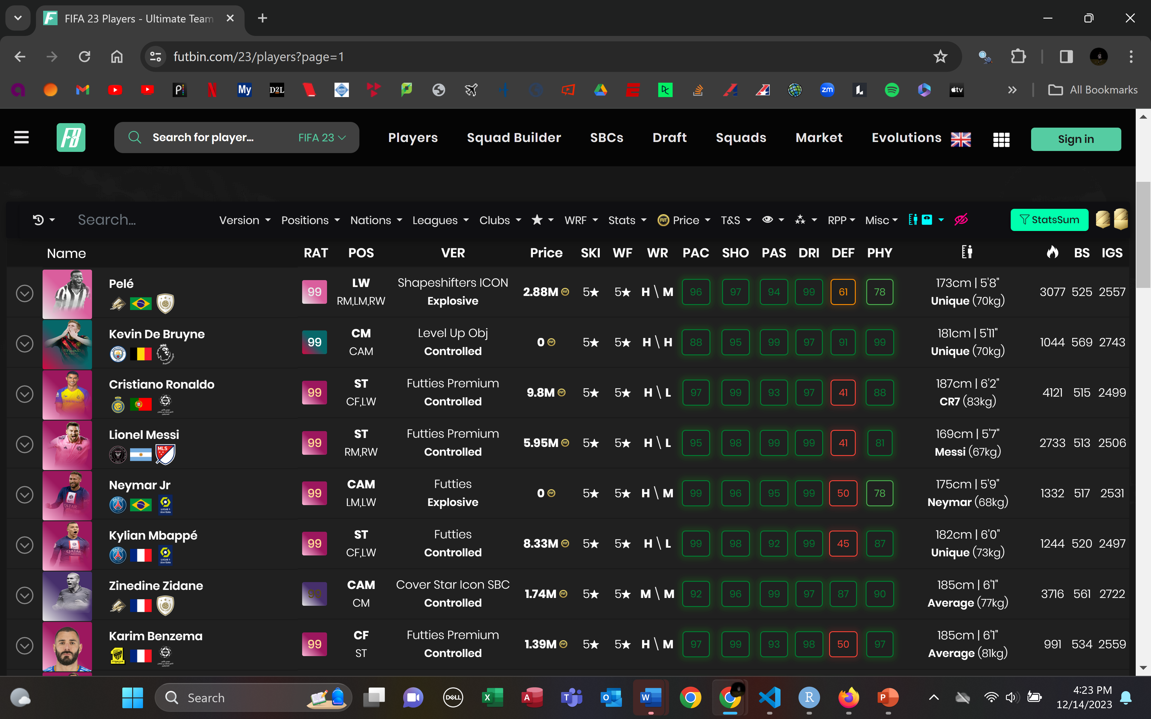
Data Source
futbin website
Commonly used for player card price history by ultimate team players
Easy and friendly UI
Allows for sorting of cards by a variety of different categories or varaibles
Fifa 23 contains just over 22,000 total player cards

Slide 6
Web Scraper
get_player = function(link) { prac <- read_html(link) pname = prac %>% html_nodes("tr:nth-child(1) .table-row-text") %>% html_text() return(pname) } get_cardtype = function(link) { prac <- read_html(link) cardtype = prac %>% html_nodes("tr:nth-child(2) .table-row-text") %>% html_text() return(cardtype) } fifa_df3 = data.frame() for (page_result in seq(from = 1, to = 34, by = 1)) { link = paste0("https://www.futbin.com/23/players?page=", page_result) page = read_html(link) player_links = page %>% html_nodes(".get-tp") %>% html_attr("href") %>% paste0("https://www.futbin.com/",.) pname1 = page %>% html_nodes(".get-tp") %>% html_text() Sys.sleep(30) card = page %>% html_nodes(".mobile-hide-table-col div:nth-child(1)") %>% html_text() Sys.sleep(30) pprice = page %>% html_nodes("span.font-weight-bold") %>% html_text() Sys.sleep(30) player = sapply(player_links, FUN = get_player, USE.NAMES = FALSE) Sys.sleep(30) cardtype = sapply(player_links, FUN = get_cardtype, USE.NAMES = FALSE) Sys.sleep(120) fifa_df3 = rbind(fifa_df3, data.frame(player, pname1, pprice, card, cardtype, stringsAsFactors = FALSE)) } write.csv(fifa_df3, "fifa_df3.csv")

Slide 7
Uncleaned Data
1 2 X.1 "1" "2" X "1" "2" player "Edson Arantes Nascimento" "Kevin De Bruyne" pname1 "Pelé" "Kevin De Bruyne" pprice "2.88M" "0" cardtype "Explosive" "Controlled" position "LW" "CM" age "83 years old" "32 years old" rating "99" "99" club "FUT ICONS" "Manchester City" league "Icons" "Premier League" nation "Brazil" "Belgium" height "173cm | 5'8\"" "181cm | 5'11\"" weight "70" "70" foot "Right" "Right" weakfoot "5" "5" skills "5" "5" attackworkrate "High" "High" defenseworkrate "Med" "High" pace "96" "88" dribbling "99" "97" shooting "97" "95" defending "61" "91" passing "94" "99" physical "78" "99" card "Shapeshifters ICON" "Level Up Obj"

Slide 8
Filtering Out Format Issues
fifa_tidy <- fifa[, -which(names(fifa) == "X.1")] fifa_tidy <- fifa %>% filter(trimws(foot) %in% c("Right","Left")) nrow(fifa_tidy)
[1] 1013
nrow(fifa)
[1] 1020

Slide 9
Cleaning Height Variable
fifa_tidy <- fifa_tidy %>% mutate_all(trimws) fifa_tidy$height <- parse_number(fifa_tidy$height)

Slide 10
Renaming Variables
names(fifa_tidy)[names(fifa_tidy) == "height"] <- "heightcm" names(fifa_tidy)[names(fifa_tidy) == "weight"] <- "weightkg" names(fifa_tidy)[names(fifa_tidy) == "pprice"] <- "price" names(fifa_tidy)[names(fifa_tidy) == "pname1"] <- "playername" names(fifa_tidy)[names(fifa_tidy) == "cardtype"] <- "attribute" names(fifa_tidy)[names(fifa_tidy) == "card"] <- "cardtype"

Slide 11
Age Variable
fifa_tidy[1,8]
[1] "83 years old"
fifa_tidy[101,8]
[1] "22-09-1976"
standardize_age <- function(age) { if (grepl("\\d{2}-\\d{2}-\\d{4}", age)) { birth_date <- as.Date(age, format = "%d-%m-%Y") age_in_years <- as.numeric(difftime(Sys.Date(), birth_date, units = "days") / 365) return(paste(round(age_in_years), "years old")) } else { return(age) } } fifa_tidy$age <- sapply(fifa_tidy$age, standardize_age) fifa_tidy$age <- parse_number(fifa_tidy$age) fifa_tidy[1,8]
[1] 83
fifa_tidy[101,8]
[1] 47

Slide 12
Price Variable
fifa_tidy <- separate(data = fifa_tidy, col = price, into = c("value", "label"), sep = -1) fifa_tidy <- fifa_tidy %>% mutate(value = case_when( label == "M" ~ as.numeric(value) * 1e+06, label == "K" ~ as.numeric(value) * 1e+03, TRUE ~ as.numeric(value) )) fifa_tidy <- fifa_tidy[, -which(names(fifa_tidy) == "label")] fifa_tidy$value[fifa_tidy$value == 0] <- NA

Slide 13
League Rank
fifa_tidy$cardtype[fifa_tidy$cardtype =="" ] <- NA fifa_tidy$rating <- as.numeric(fifa_tidy$rating) rank<-fifa_tidy %>% group_by(league) %>% summarise(rank = mean(rating)) %>% arrange(desc(rank)) fifa_tidy <- fifa_tidy %>% mutate(league_rank = case_when( league == "Chinese FA Super L. (CHN 1)" ~ 1, league == "LaLiga Santander" ~ 2, league == "Ligue 1" ~ 3, league == "Serie A TIM" ~ 4, league == "MBS Pro League (SAU 1)" ~ 5, league == "Premier League" ~ 6, league == "Eliteserien (NOR 1)" ~ 7, league == "Italy Serie B (2)" ~ 8, league == "Bundesliga" ~ 9, league == "Major League Soccer" ~ 10, league == "Süper Lig (TUR 1)" ~ 11, league == "Liga NOS (POR 1)" ~ 12, league == "3F Superliga (DEN 1)" ~ 13, league == "1A Pro League (BEL 1)" ~ 14, league == "EFL League One (ENG 3)" ~ 15, league == "Polski Ekstraklasa (POL 1)r" ~ 16, league == "Scottish Premiership (SPFL)" ~ 17, league == "A-League (AUS 1)" ~ 18, league == "Eredivisie" ~ 19, league == "Icons" ~ 20, league == "EFL Championship (ENG 2)" ~ 21, league == " Ligue 2 (FRA 2)" ~ 22, league == "National League (ENG 5)" ~ 23, league == "World Cup" ~ 24, league == "EFL League Two (ENG 4)" ~ 25, league == "Hellas Liga (GRE 1)" ~ 26, TRUE ~ NA_real_ ))

Slide 14
Cardtype Rank
cardtype_ranks <- fifa_tidy %>% group_by(cardtype) %>% summarise(rank = mean(rating)) %>% arrange(desc(rank)) %>% mutate(cardtype_rank = row_number()) add_cardtype_rank <- function(fifa_observation) { result <- fifa_observation %>% left_join(cardtype_ranks %>% select(cardtype, cardtype_rank), by = "cardtype") return(result) } fifa_tidy <- fifa_tidy %>% group_split() %>% map_df(add_cardtype_rank)

Slide 15
Continuation of Price Variable
fifa_tidy <- fifa_tidy %>% group_by(rating, cardtype) %>% mutate(value = ifelse(is.na(value), median(value, na.rm = TRUE), value)) fifa_tidy <- fifa_tidy %>% filter(value != "NaN")

Slide 16
Data Types
fifa_tidy$rating <- as.numeric(fifa_tidy$rating) fifa_tidy$league_rank <- as.numeric(fifa_tidy$league_rank) fifa_tidy$cardtype_rank <- as.numeric(fifa_tidy$cardtype_rank) fifa_tidy$weightkg<- as.numeric(fifa_tidy$weightkg) fifa_tidy$weakfoot<- as.numeric(fifa_tidy$weakfoot) fifa_tidy$skills<- as.numeric(fifa_tidy$skills) fifa_tidy$pace<- as.numeric(fifa_tidy$pace) fifa_tidy$dribbling<- as.numeric(fifa_tidy$dribbling) fifa_tidy$shooting<- as.numeric(fifa_tidy$shooting) fifa_tidy$defending<- as.numeric(fifa_tidy$defending) fifa_tidy$passing<- as.numeric(fifa_tidy$passing) fifa_tidy$physical<- as.numeric(fifa_tidy$physical) fifa_tidy$attribute <- as.factor(fifa_tidy$attribute) fifa_tidy$position <- as.factor(fifa_tidy$position) fifa_tidy$foot <- as.factor(fifa_tidy$foot) fifa_tidy$attackworkrate <- as.factor(fifa_tidy$attackworkrate) fifa_tidy$defenseworkrate <- as.factor(fifa_tidy$defenseworkrate) fifa_tidy <- fifa_tidy[, -which(names(fifa_tidy) == "X.1")] fifa_tidy <- fifa_tidy[, -which(names(fifa_tidy) == "X")]

Slide 17
Variables
26 total variables and 927 observations after cleaning.
1) player: Birth name of the player. Character data type.
2) playername: Name on the card, typically what most people know the player as. Character data type.
3) value: Current selling price of the card. Numeric data type.
4) attribute: Player attribute. 3 level factor data type of either explosive, controlled, or lengthy
5) position: Position for player on the card, important to note that some cards are created that have players assigned to a position different from their natural or usual position. 15 level factor data type.
6) age: Age of player, important to note that deceased players age is recorded as how old they would be if still alive today. Numeric data type.
7) rating: Player card rating is integer between 1 and 99 comprised or calculated from weighted card variables based on position. Numeric data type.
8) Club: Club team that the player currently plays for. Character data type.
9) League: League that players club team currently competes in. Character data type.
10) Nation: Nationality of player. Character data type.
11) Height: Player height recorded in centimeters. Numeric data type.
12) Weight: Player weight recorded in kilograms. Numeric data type.
13) Foot: Players preferred foot. 2 level factor variable, either right or left
14) Weakfoot: Rating out of five for the players non-dominate foot. Numeric data type.
15) Skills: Rating out of five for the players skill and dribbling moves they can perform. Numeric data type.
16) Attacking Work Rate: Players work rate on offense. 3 level factor variable, either high, med, or low.
17) Defensive Work Rate: Players work rate on defense. 3 level factor variable, either high, med, or low
18) Pace: Measure of player speed as an integer between 1 and 99. Numeric data type.
19) Dribbling: Measure of player dribbling ability as an integer between 1 and 99. Numeric data type.
20) Shooting: Measure of player shooting ability as an integer between 1 and 99. Numeric data type.
21) Defending: Dribbling: Measure of player defensive ability as an integer between 1 and 99. Numeric data type.
22) Passing: Measure of player passing ability as an integer between 1 and 99. Numeric data type.
23) Physical: Measure of player physical statute as an integer between 1 and 99. Numeric data type.
24) Cardtype: Type of player card. Character data type.
25) League Rank: Derived from the mean player rating in a given league with 1 representing the league with the highest mean player rating. Numeric data type.
26) cardtype Rank: Derived from the mean player rating for a given cardtype with 1 representing the cardtype with the highest mean player rating. Numeric data type.

Slide 18
Cleaned Observation
1 player "Edson Arantes Nascimento" playername "Pelé" value "2880000" attribute "Explosive" position "LW" age "83" rating "99" club "FUT ICONS" league "Icons" nation "Brazil" heightcm "173" weightkg "70" foot "Right" weakfoot "5" skills "5" attackworkrate "High" defenseworkrate "Med" pace "96" dribbling "99" shooting "97" defending "61" passing "94" physical "78" cardtype "Shapeshifters ICON" league_rank "20" cardtype_rank "15"

Slide 19
Models
For all models developed a subset of the tidy data frame was created containing only numeric data. This resulted in a total of 15 observations: value, age, rating, height, weight, weakfoot, skills, pace, dribbling, shooting, defending, passing, physical, league_rank, and cardtype_rank.
Models built include Best Subset Selection linear regression, LASSO Regression, and Principal Component Analysis
fifa_tidy2 <- na.omit(fifa_tidy) numeric_cols <- sapply(fifa_tidy2, is.numeric) numeric_data <- fifa_tidy2[, numeric_cols]

Slide 20
Subset Selection
leaps library in R
Best subset selection builds linear models with every possible variable combination from the imputed data frame resulting in $2^{n}$ possible models where $n$ represents the number of variables in the data frame.
Adjusted R squared used for model selection

Slide 21
Subset Selection
Subset selection object Call: regsubsets.formula(rating ~ ., data = numeric_data) 14 Variables (and intercept) Forced in Forced out value FALSE FALSE age FALSE FALSE heightcm FALSE FALSE weightkg FALSE FALSE weakfoot FALSE FALSE skills FALSE FALSE pace FALSE FALSE dribbling FALSE FALSE shooting FALSE FALSE defending FALSE FALSE passing FALSE FALSE physical FALSE FALSE league_rank FALSE FALSE cardtype_rank FALSE FALSE 1 subsets of each size up to 8 Selection Algorithm: exhaustive value age heightcm weightkg weakfoot skills pace dribbling shooting 1 ( 1 ) " " " " " " " " " " " " " " " " " " 2 ( 1 ) " " " " " " " " "*" " " " " " " " " 3 ( 1 ) "*" " " " " " " "*" " " " " " " " " 4 ( 1 ) "*" " " " " " " "*" " " " " "*" " " 5 ( 1 ) "*" " " " " " " "*" " " " " "*" " " 6 ( 1 ) "*" "*" " " " " "*" " " " " "*" " " 7 ( 1 ) "*" "*" " " " " "*" " " " " "*" " " 8 ( 1 ) "*" "*" " " " " "*" " " " " "*" " " defending passing physical league_rank cardtype_rank 1 ( 1 ) " " " " " " " " "*" 2 ( 1 ) " " " " " " " " "*" 3 ( 1 ) " " " " " " " " "*" 4 ( 1 ) " " " " " " " " "*" 5 ( 1 ) " " " " "*" " " "*" 6 ( 1 ) " " " " "*" " " "*" 7 ( 1 ) " " " " "*" "*" "*" 8 ( 1 ) "*" " " "*" "*" "*"
[1] 8
[1] 0.6754143
(Intercept) value age weakfoot dribbling 7.805672e+01 6.766768e-07 3.452439e-02 5.925446e-01 9.148227e-02 defending physical league_rank cardtype_rank 8.422565e-03 5.244909e-02 -2.956854e-02 -5.336696e-02

Slide 22
Shrinkage Methods
glmnet library in R
Unlike subset selection algorithms such as best, which completely remove certain variables from the model, shrinkage methods keep all variables in the model but reduce the coefficients of less important explanatory variables towards zero. In the case of LASSO regression coefficients are able to be set equal to zero for variables in the model eliminating relationships between explanatory and dependent variables.
Lambda used as a tuning parameter, as lambda increases so does the potential for bias in the model
Prediction variances decrease with the correct selection of lambda

Slide 23
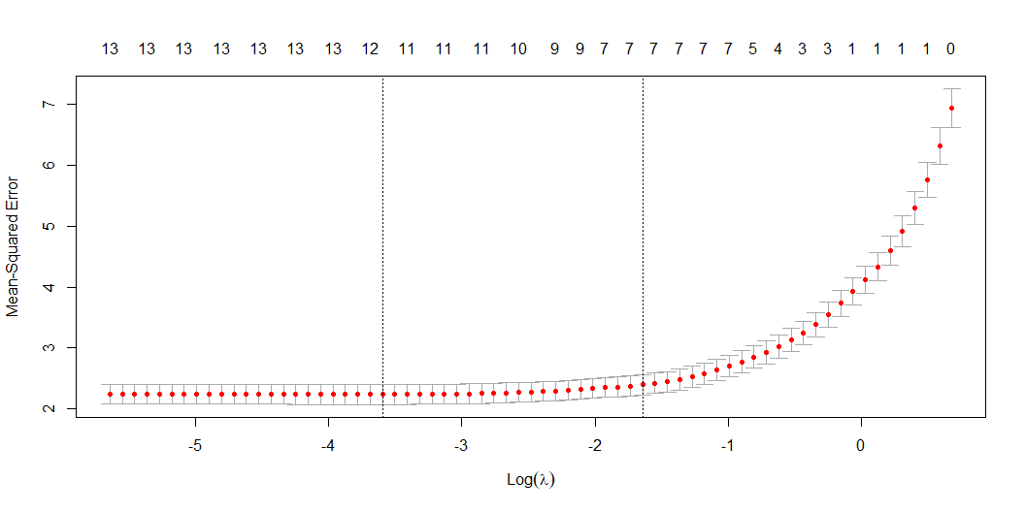
Shrinkage Methods

Slide 24
[1] 0.02740794
[1] 0.681213
(Intercept) value age heightcm weightkg 7.805940e+01 6.323888e-07 2.893751e-02 0.000000e+00 1.761067e-04 weakfoot skills pace dribbling shooting 5.459947e-01 7.356950e-02 1.837928e-02 5.604552e-02 0.000000e+00 defending passing physical league_rank cardtype_rank 5.086170e-03 1.930035e-02 5.277880e-02 -2.079523e-02 -5.130736e-02

Slide 25
Dimensionality Reduction
prcomp in base R and factoextra library used for visualizations
transforming data from a high dimensional space to a lower dimensional space while retaining as much possible information and variance from the original data set
Downsides of highly dimensional data include immense computational power and time, difficultly in visualization development, and the curse of dimensionality.
This study will employ principal component analysis as a means of dimensionality reduction
scale=TRUE was used to to convert very variable to have a total variance of 1

Slide 26
PCA
PC1 PC2 PC3 PC4 PC5 value -0.131802282 -0.006503092 0.2273626074 -0.17996138 0.88377045 age 0.132098378 0.321804458 0.2651413393 -0.50853488 -0.11131412 rating -0.324887363 -0.233671870 0.1042167941 -0.33165179 0.08097818 heightcm 0.142839565 -0.310369517 0.5133812540 0.15128202 -0.11168626 weightkg 0.127725363 -0.237625525 0.5482780041 0.17218851 -0.10130057 weakfoot -0.277180708 -0.011396872 0.1726582260 -0.06601607 -0.08194047 skills -0.333922188 0.185772706 0.0327659926 0.07610951 -0.01979131 pace -0.335531084 -0.078316615 0.0007938586 0.05479809 0.02988031 dribbling -0.416440454 0.079996920 0.0176391653 0.07265180 -0.13118791 shooting -0.314427890 0.217267000 0.3037907768 0.14638690 -0.18503515 defending 0.110114756 -0.406924190 -0.3370838446 -0.31504754 -0.08979843 passing -0.356101419 0.001604531 -0.1184205982 -0.10841071 -0.22738618 physical -0.004240696 -0.510231487 0.0892818173 -0.13462799 -0.12084920 league_rank 0.150085366 0.266389375 0.2056277787 -0.56198975 -0.20361320 cardtype_rank 0.297036291 0.312623183 0.0398501022 0.24829842 0.04458389

Slide 27
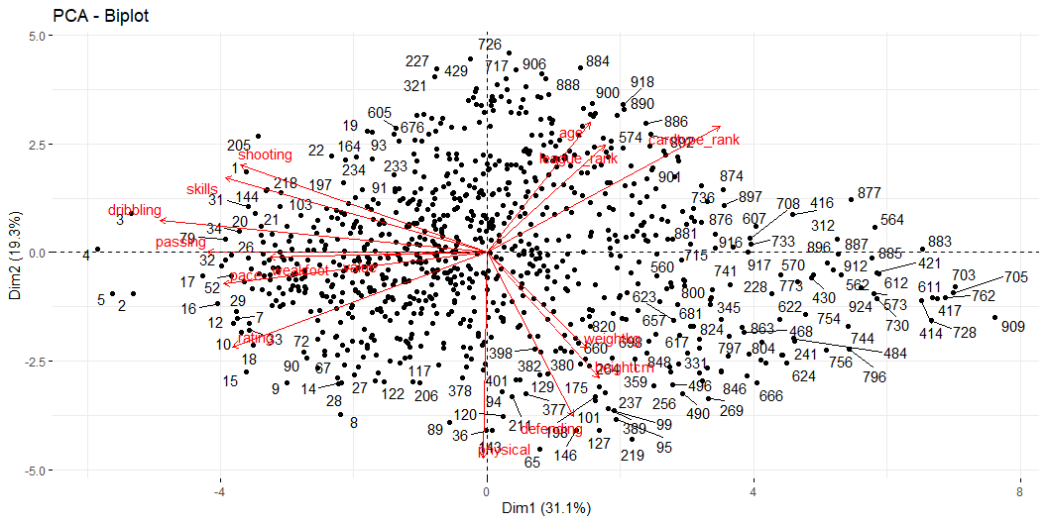
PCA

Slide 28
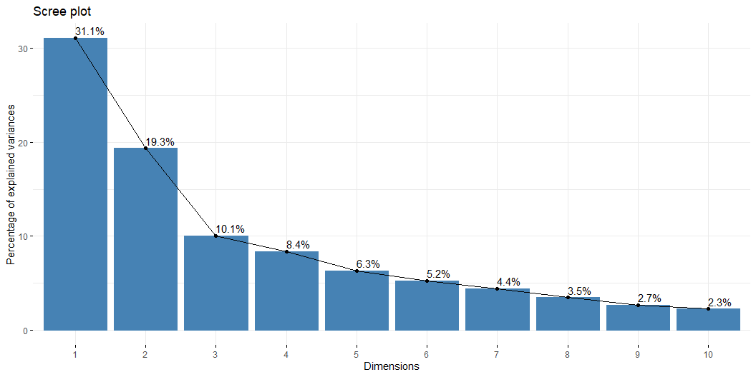
PCA

Slide 29
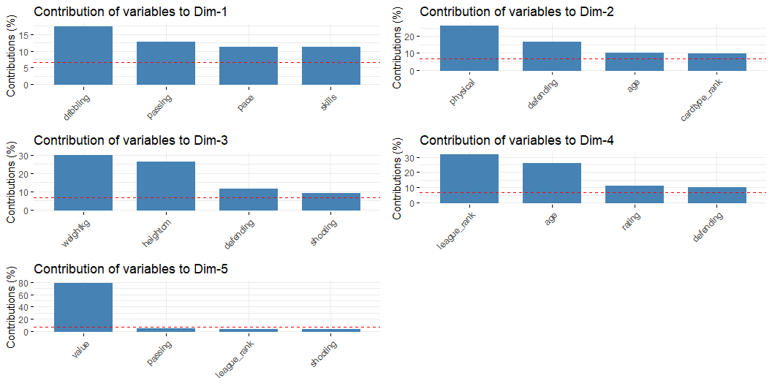
PCA

Slide 30
PCA
k <- 5 reduced_data <- as.matrix(numeric_data) %*% P$rotation[, 1:5] reduced_data <- as.data.frame(reduced_data) names(reduced_data)[names(reduced_data) == "PC1"] <- "attacking" names(reduced_data)[names(reduced_data) == "PC2"] <- "defending" names(reduced_data)[names(reduced_data) == "PC3"] <- "playersize" names(reduced_data)[names(reduced_data) == "PC4"] <- "league" names(reduced_data)[names(reduced_data) == "PC5"] <- "value"

Slide 31
PCA
attacking defending playersize league value 1 -379704.7 -18827.76 654976.1 -518346.3 2545163 2 -1291784.0 -63852.77 2228332.9 -1763638.8 8660860 3 -784351.3 -38802.11 1352967.7 -1070794.6 5258346 4 -1098041.5 -54289.81 1894087.9 -1499098.7 7361722 5 -1098040.9 -54297.55 1894095.8 -1499092.3 7361721 6 -229452.1 -11450.74 395775.1 -313185.1 1537661

Slide 32
Best vs LASSO
Best built on 8 variables with an adjusted R squared of 0.675
LASSO built on 13 variables with an adjusted R squared of 0.681
Coefficient interpretations
(Intercept) value age weakfoot dribbling 7.805672e+01 6.766768e-07 3.452439e-02 5.925446e-01 9.148227e-02 defending physical league_rank cardtype_rank 8.422565e-03 5.244909e-02 -2.956854e-02 -5.336696e-02
(Intercept) value age heightcm weightkg 7.805940e+01 6.323888e-07 2.893751e-02 0.000000e+00 1.761067e-04 weakfoot skills pace dribbling shooting 5.459947e-01 7.356950e-02 1.837928e-02 5.604552e-02 0.000000e+00 defending passing physical league_rank cardtype_rank 5.086170e-03 1.930035e-02 5.277880e-02 -2.079523e-02 -5.130736e-02

Slide 33
PCA Results
New data frame created for first 5 PC’s
Reduced the data frame from 15 to 5 features while retaining 75% of the total variance from original data frame
attacking defending playersize league value 1 -379704.7 -18827.76 654976.1 -518346.3 2545163

Slide 34
Future Work and Use Cases
Linear model created using the reduced data and comparing to Best and LASSO models
Best team for a given price

Slide 35
References
Al-Asadi, Mustafa. “Predict the Value of Football Players Using FIFA Video Game Data and Machine Learning Techniques.” Ieexplore, 25 Feb. 2022, ieeexplore.ieee.org/document/9721908/.
Cotta, Leonardo. “Using FIFA Soccer Video Game Data for Soccer Analytics.” Universidade Federal De Minas Gerais, Brazil, homepages.dcc.ufmg.br/~fabricio/download/lssa_fifa_CR.pdf. Accessed 13 Dec. 2023.
“EA SportsTM FIFA 23 - Official Site - Electronic Arts.” Ea, www.ea.com/games/fifa/fifa-23. Accessed 13 Dec. 2023.
Futbin. “FIFA 23 Players.” FUTBIN, www.futbin.com/23/players?page=1. Accessed 13 Dec. 2023.
Mbu-Ogar, Seyi. “FIFA 23 Exploratory Data Analysis.” Medium, Medium, 5 July 2023, medium.com/@seyiogar/fifa-23-exploratory-data-analysis-ed56ea424f48.
Rodriguez V., Erick Daniel Rodriguez. “Machine Learning on FIFA 20.” Medium, Towards Data Science, 13 Nov. 2020, towardsdatascience.com/fifa-20-player-clustering-f500cf0792c5.
Silvestri, Christian. “Top 10 Best Selling FIFA Games of All Time.” FIFA Infinity, 10 Aug. 2023, www.fifa-infinity.com/fifa-23/top-10-best-selling/#:~:text=FIFA%2023%20%E2%80%93%2010.3%2B%20million%20units%20sold&text=Building%20on%20the%20success%20of,licensed%20leagues%2C%20and%20gameplay%20enhancements.
Smith, Kieran. “When Was the First Ever FIFA Ultimate Team?” GiveMeSport, 16 Jan. 2023, www.givemesport.com/88105399-when-was-the-first-ever-fifa-ultimate-team

